Slide 1
Multiple Linear Regression

Slide 2
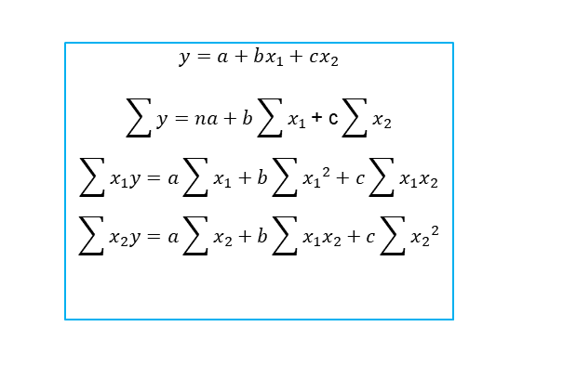
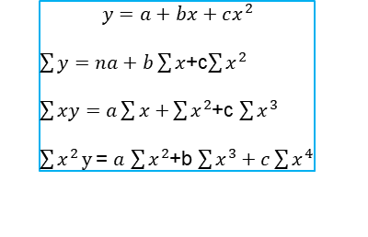
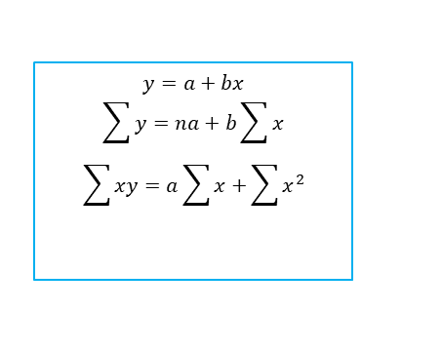
Normal Estimation Equation for linear , polynomial and Multiple linear regression
$$y=a+bx$$
$$\sum{y}=na+b\sum{x}$$
$$\sum{xy=a\sum{x+}}\sum{x^{2}}$$
$$y=a+bx_{1}+cx_{2}$$
$$\sum{y}=na+b\sum{x_{1}}\text{+} \text{c}\sum{x_{2}}$$
$$\sum{x_{1}y}=a\sum{x_{1}}+b\sum{{x_{1}}^{2}+c\sum{x_{1}x_{2}}}$$
$$\sum{x_{2}y}=a\sum{x_{2}}+b\sum{x_{1}x_{2}+c\sum{{x_{2}}^{2}}}$$
$$y=a+bx+cx^{2}$$
$\sum{y}=na+b\sum{x}$+c$\sum{x^{2}}$
$\sum{xy=a\sum{x+}}\sum{x^{2}}$+c $\sum{x^{3}}$
$\sum{x^{2}}y$= $a$ $\sum{x^{2}}$+b $\sum{x^{3}+c\sum{x^{4}}}$

Slide 3

Multiple Regression Model
In multiple regression, there are several independent variables and one dependent variable, and the equation is:

Slide 4
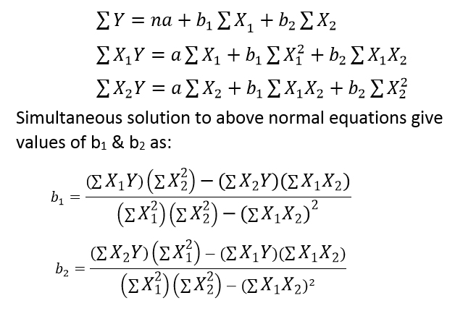
Normal equations for Regression Coefficient for two independent variables

Slide 5
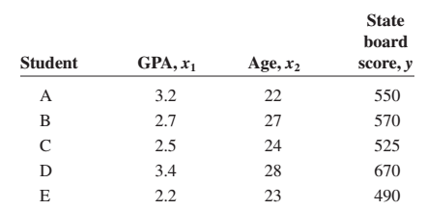
Example # 01
For example, suppose a teacher wishes to see whether there is a relationship between a student’s grade point average, age, and score on the state board examination. The two independent variables are GPA (denoted by x1) and age (denoted by x2).

Slide 6


Example # 01
The multiple regression obtained from the data is:
if a student has a GPA of 3.0 and is 25 years old, the student’s predicted state board score is:

Slide 7
Assumptions for Multiple linear Regression
E (ϵ) = 0
The regression equation is linear in the parameters.
V(ϵ) = σ².
The population distribution of ϵ is normal.
The values for the y variables are independent.
The independent variables are not correlated.

Slide 8
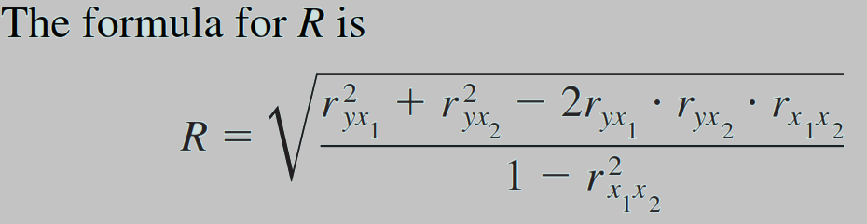
Multiple Correlation (R)
The value of R takes into account all the independent variables.
The value of R can range from 0 to 1; R can never be negative.
The closer to 1, the stronger the relationship; the closer to 0, the weaker the relationship.

Slide 9
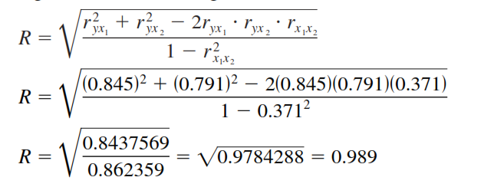
Example # 02
For the data regarding state board scores, find the value of R.

Slide 10
Coefficient of Multiple Determination (R²)
R² is the coefficient of multiple determination, and it is the amount of variation explained by the regression model.

Slide 11

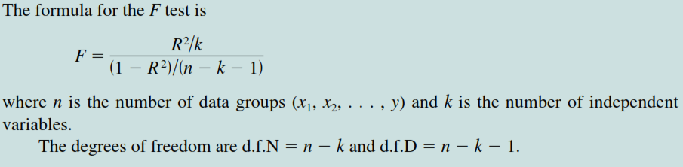
Significance of R
An F test is used to test the significance of R. The hypotheses are

Slide 12
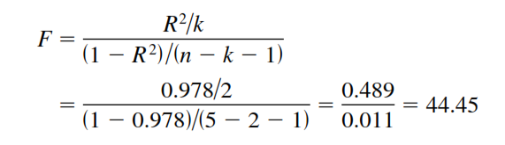
Example # 03
Test the significance of the R obtained in Example 02 at α = 0.05.
The critical value obtained, d.f.N (υ1)= 3, and d.f.D (υ2)=5 - 2 -1 = 2 is 19.16. Hence, the decision is to reject the null hypothesis.

Slide 13
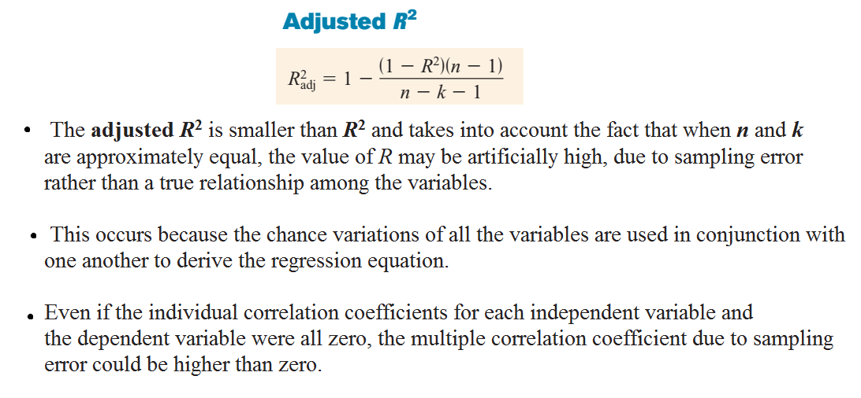

Slide 14
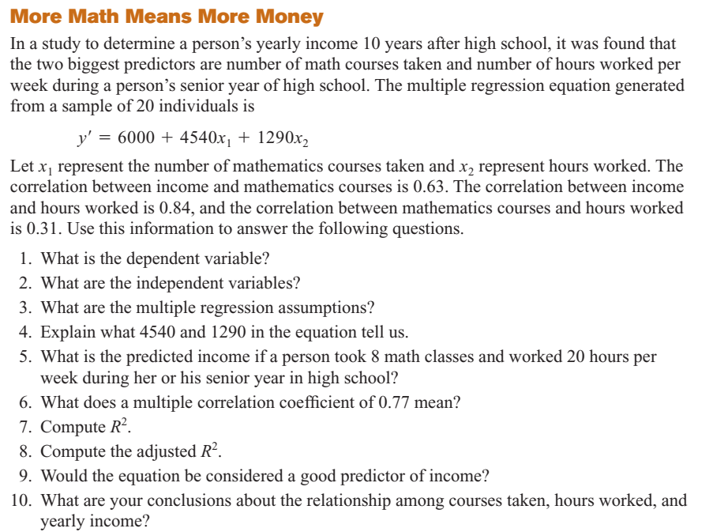
Notes:
Case study

Slide 15
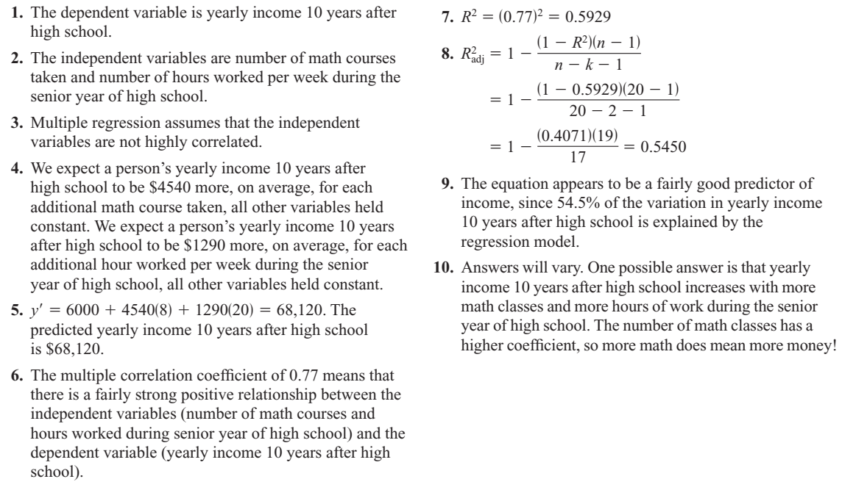

Slide 16
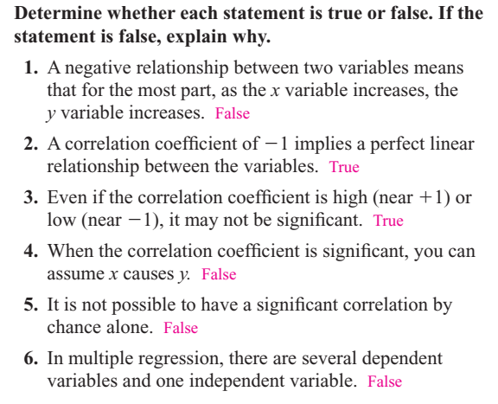

Slide 17
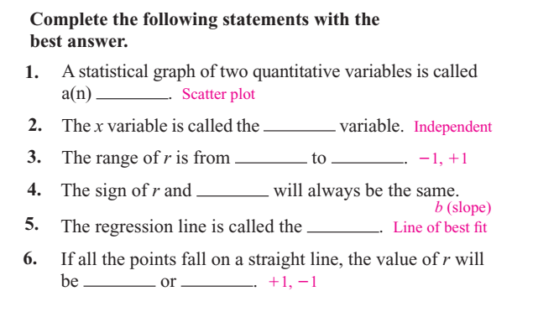

Slide 18
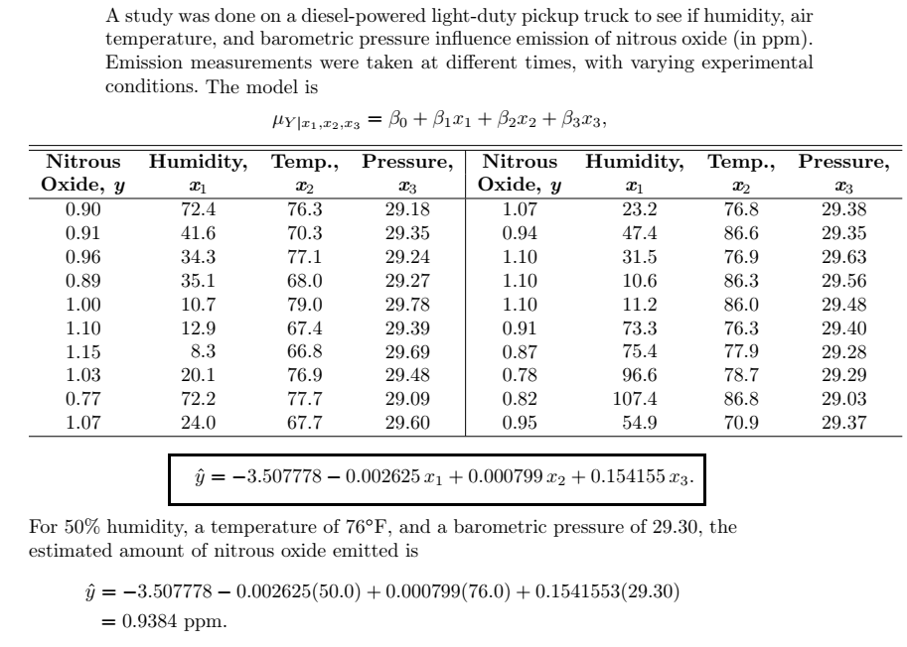
Example: Emission of nitrous oxide

Slide 19
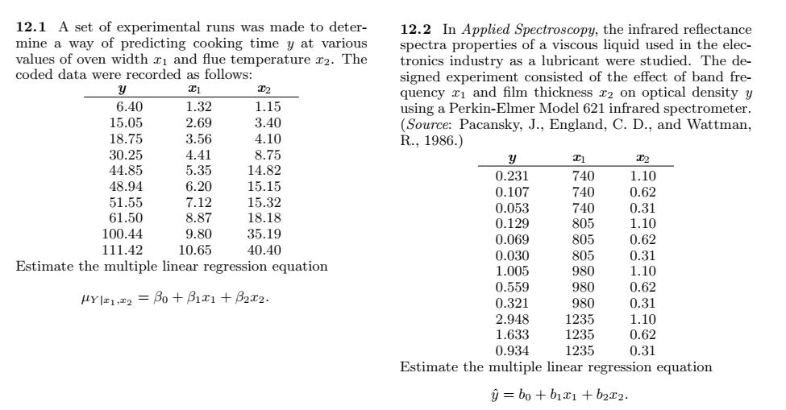
Example:

Slide 20
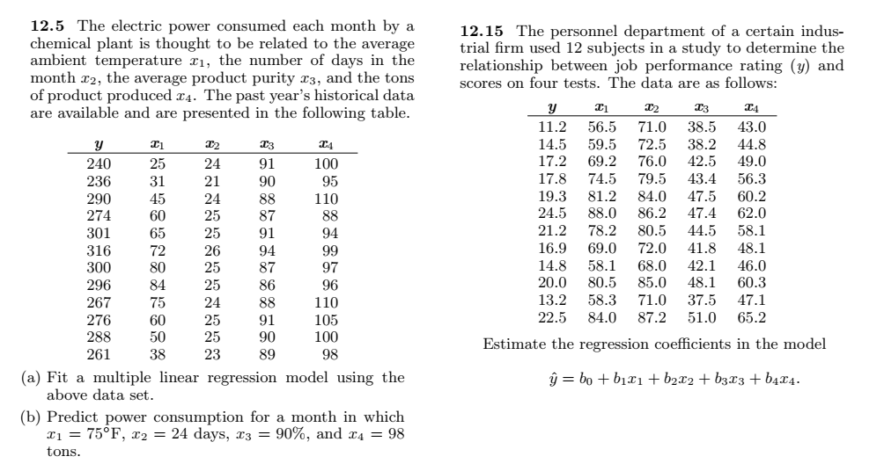

Slide 21
Polynomial regression (optional)

Slide 22
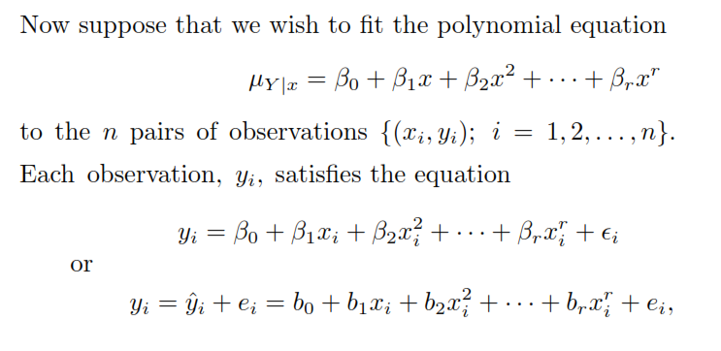
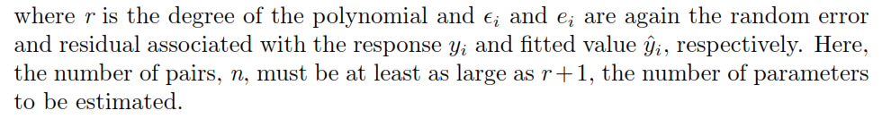
Polynomial Regression

Slide 23
Example # 04
Given the data
ﬁt a regression curve of the form and then estimate

Slide 24
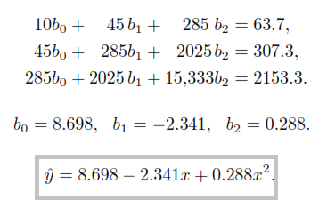

Example # 04 (Contd.)

Slide 25
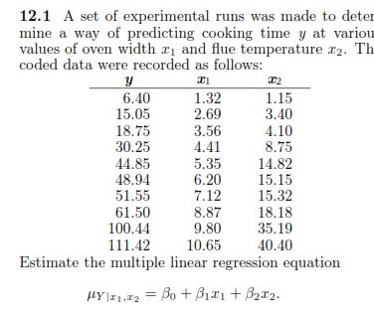
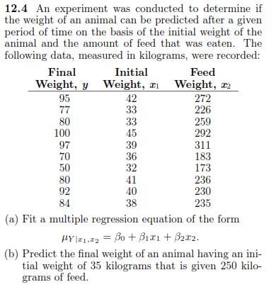
Practice Questions

Slide 26
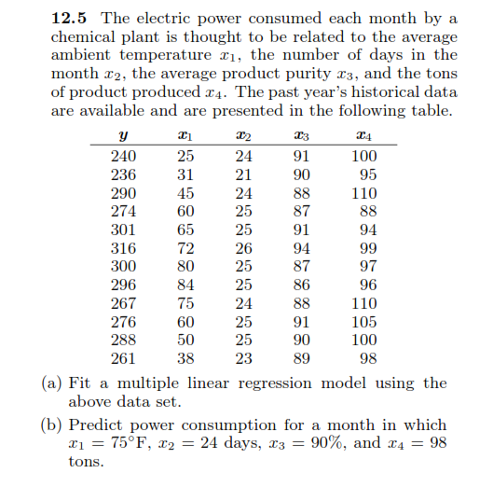
Practice Questions (Contd.)

Slide 27
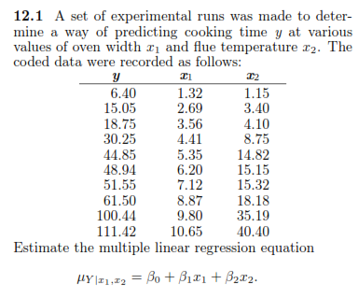
Practice Questions (Contd.)

Slide 28
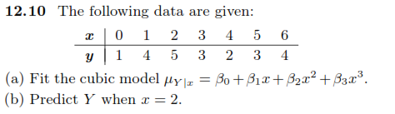
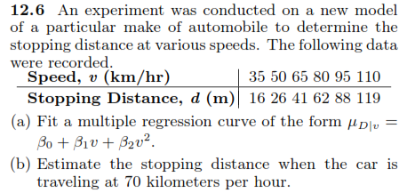
Practice Questions (Contd.)

Slide 29
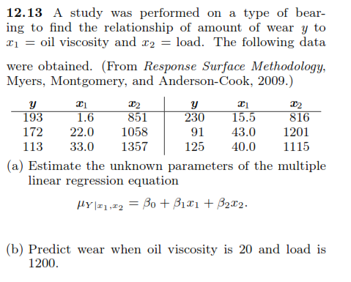
Practice Questions

